Slide 1

The location recommendation to new restaurants
Eva lI

Slide 2
Introduction
Location is the most important factor of success to open a new restaurant. There are some key indexes to evaluate if the location is good or not:
How's the neighborhood in terms of population to check if the restaurant would meet local consumers' needs
What's the current competition situation within the location, in terms of the number of restaurants, cuisines offering, comments, etc.
What's the future opportunity within the location, considering local development plan
This project will conduct an analysis on Toronto neighborhood to set up a model for investors to make decision on how to select the location for their new restaurants.

Slide 3
Data Acquisition
Here is the data list used for this analysis:
List of postal codes of Toronto from WIKIPEDIA
Geospatial Coordinates CSV file for Toronto postal codes from http://cocl.us/Geospatial_data
Foursquare API

Slide 4
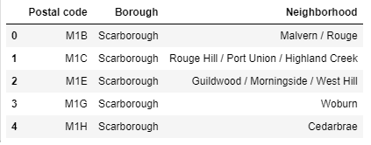
Data Acquisition
The process of data cleaning on postal codes of Toronto:
Read the HTML text using BeautifulSoup library of the list of postal codes of Toronto
Group neighborhood with the same postal code
Drop data that without info. of Borough

Slide 5
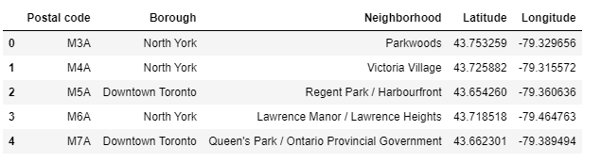
Data Acquisition
Merge Geo-spatial coordinates into the dataframe
Read the Geospatial Coordinates CSV file from website: http://cocl.us/Geospatial_data
Merge it into Postal Code dataframe by matching with Postal code column

Slide 6
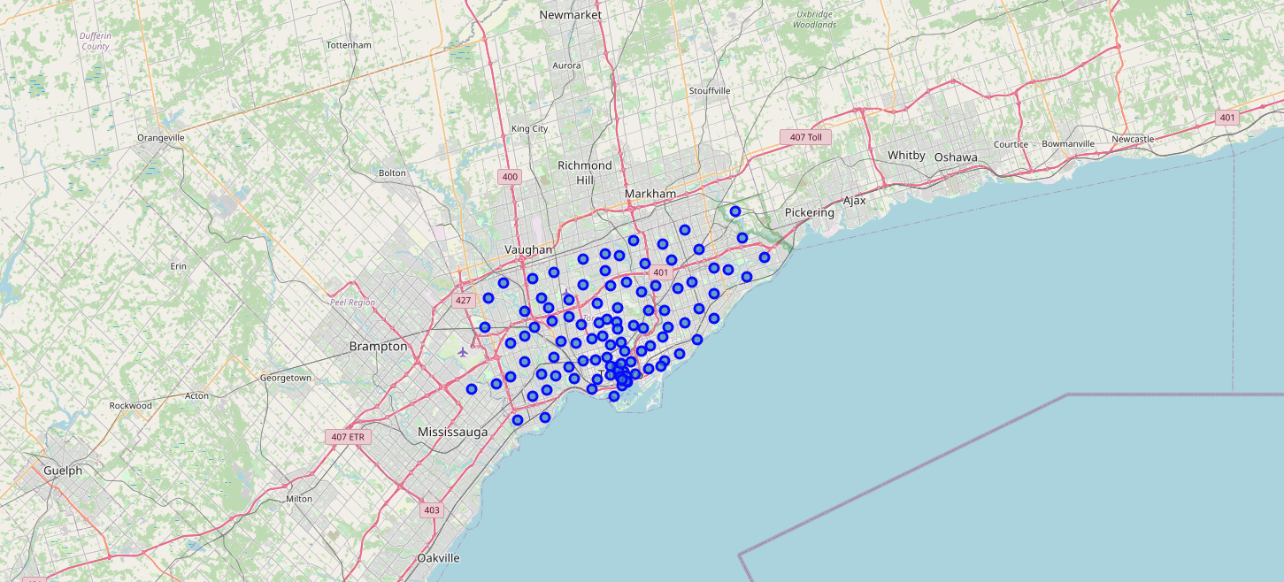
A map of Toronto by using Folium library

Slide 7
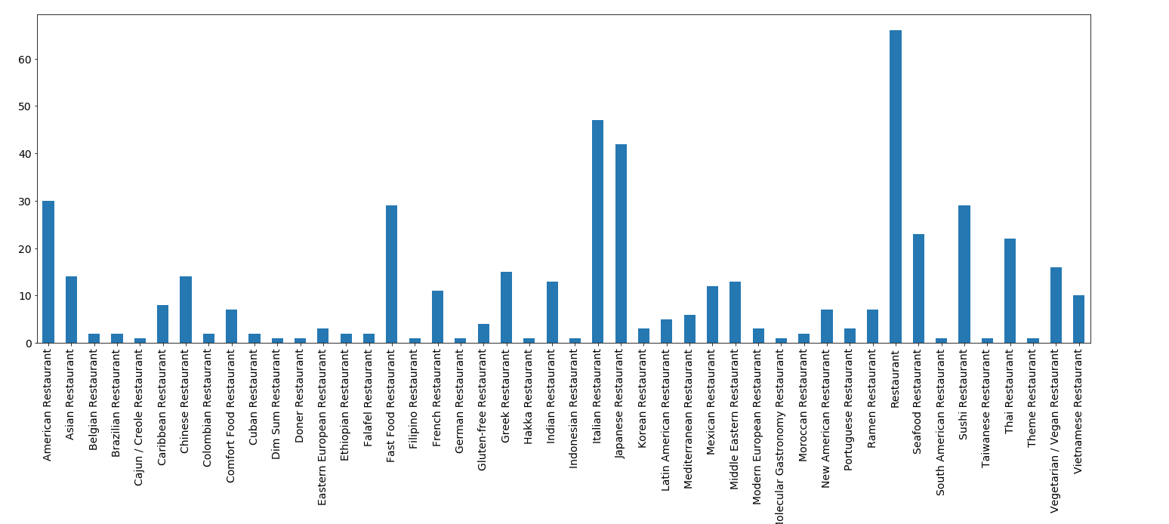
Explore the neighborhoods and segment by using Foursquare API
By linking with Foursquare API, we can check out the top100 restaurants in each neighborhoods within a radius of 500 metres, with the info. of restaurant name and category. And then we grouped them by neighborhood.
To make the data clear, we only selected those categories with ‘restaurant’ in category name. Here is the distribution of all types of restaurant at Toronto.

Slide 8
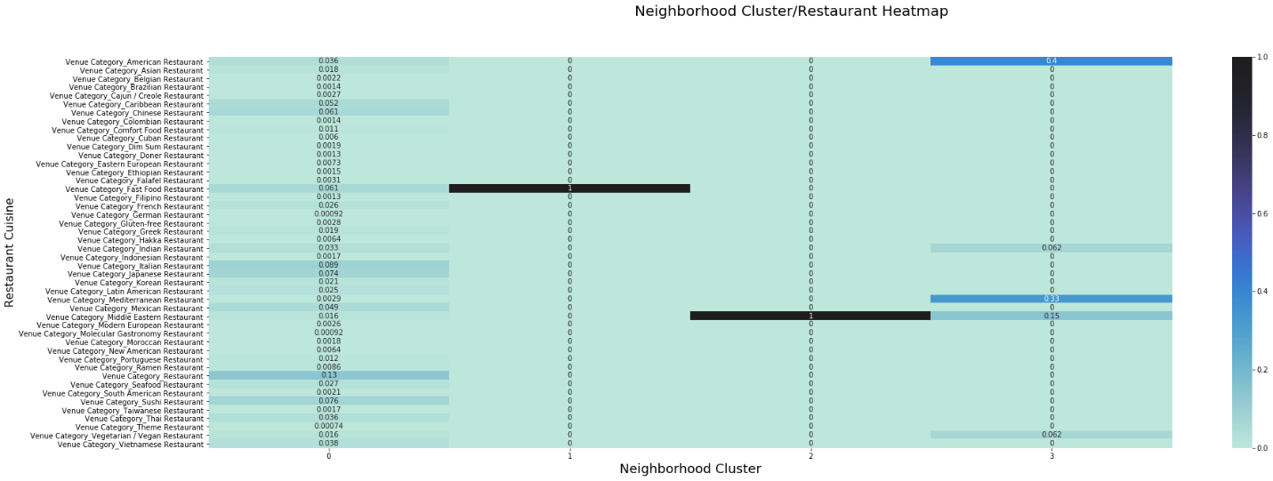
Data Analysis
I use K-means clustering and popularity recommendation filtering aproach to make the data analysis. With K=4, I split neighborhood to 4 clusters.
In this stage, I merged cluster labels to the dataset, and then grouped the dataset by cluster. The we got the heatmap of restaurants in each cluster.

Slide 9
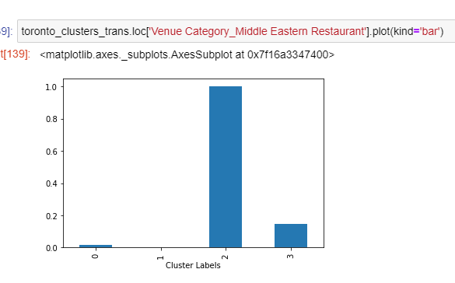
Conclusion
By using the heatmap above, we can check the frequency of a certain type of restaurant in each cluster. For example, Middle Eastern restaurant frequency is very high in cluster2 than others, which means if someone want to start a Middle Eastern restaurant in the neighborhood of cluster2, the competition would be fiercer than on other areas.

